Slide 1


Link creation and profile alignment in the aNobii social network
2nd IEEE International Conference on Social Computing
Speaker:
Luca Maria Aiello, PhD student
aiello@di.unito.it
Authors:
Università degli Studi di Torino
ISI Foundation
Luca Maria Aiello
Giancarlo Ruffo
Rossano Schifanella
Alain Barrat
Ciro Cattuto
Keywords : link creation, homophily, social influence, aNobii
Notes:
Good morning everyone, my name is Luca Aiello from University of Turin and my talk will be about link creation and profile alignment in the aNobii social network. This is a joint work by my colleagues from University of Turin and by Alain Barrat and Ciro Cattuto from the ISI foundation in Turin.

Slide 2


Open questions in social network analysis
What are the dynamics leading to link creation?
What is the interplay between user similarity and link creation?
Notes:
So I will talk a bit about mainly two subjects, that are quite important open topics in evolutionary network analysis.
First we try to answer to a very broad question which is “What are the dynamics leading to link creation?”. This means that we try to bring out the causes that lead two social agents to get connected to each other, with a particular attention to the social media context.
Then, in the second part of the talk we will try to learn something on another crucial topic in social dynamics, which is the interplay between similarity and link creation. Specifically, here I will talk about the interplay between homophily and influence phenomena that are observed in social networks.

Slide 3
Outline
Dataset
Static analysis
Geographic analysis
Dynamical analysis
Conclusions
Notes:
Here’s the list of points. First I will shortly describe the dataset we used. Then the analysis is partitioned into static, geographic and dynamical analysis

Slide 4
Outline
Dataset
Static analysis
Geographic analysis
Dynamical analysis
Conclusions
Notes:
Let’s start with the dataset definition

Slide 5
Social network for bookworms
Data-driven analysis on anobii.com
Profile features
  Library and wishlist
  Groups
  Tags
Social network
  Directed
  Friendship + neighborhood
4th snapshot | Friendship | Neighborhood | Union
Nodes | 74,908 | 54,590 | 86,800
Links | 268,655 | 429,482 | 697,910
6 snapshots, 15 days apart
Full giant connected component
Notes:
Our dataset is taken from the aNobii website, a social network for book readers that was created in Hong Kong but that soon became popular in Italy.
aNobii is a social media and exposes both the two aspects that define participants: the profile features and the social network connections. The dataset is very rich: users can compose their public library containing the books they have read, annotate books with tags, rate them review them or compose a wishlist of books they wish to read. Users can also affiliate to thematic, user-defined groups.
On the other way, the social network has two particular features: first it is directed, second it is partitioned in two different mutually exclusive ties which are friendship and neighborhood ties. They are totally equivalent and established by the users but the website suggests to use friendship for people who you know in real life and neighborhood for people that you do not know but whose library you find interesting.

Slide 6
Outline
Dataset
Static analysis
Geographic analysis
Dynamical analysis
Conclusions
Notes:
So, let’s start with a preliminary static analysis

Slide 7
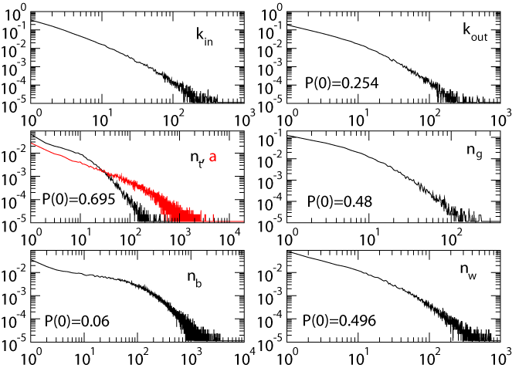
Basic statistics
<k_{out}> | 8.0
Reciprocation | 0.57
Avg SPL | 5.3
Diameter | 20
Broad distributions
High reciprocation
High diameter
Notes:
Here there are some basic statistic, I’m sure you’ll find them very familiar.
In the table we have a short list of basic quantities like the average out degree, the reciprocation degree, which is the portion of directed links that are reciprocated, the average shortest path length and the diameter, i.e., the maximum shortest path length. The diameter is very high for a network of one hundred thousand nodes, this is very curious. I will explain the reason for this in next few slides. On the right we have distributions of the degrees, the number of tags and annotations the number of groups, of books in the library and in the wishlist.
Just to summarize, this preliminary analysis shows the expected broad distributions for all the quantities, a high reciprocation degree and this strange high diameter.

Slide 8
Correlations and mixing patterns
Pearson correlation
 | k_{out} | n_{g} | n_{b} | n_{w}
k_{out} | 1 | 0.31 | 0.18 | 0.18
n_{g} |  | 1 | 0.32 | 0.31
n_{b} |  |  | 1 | 0.22
Positive correlations between:
  Connectivity and activity
  Different activities
Assortativity (n.s.)
Notes:
Here we have more statistics on correlations: on the right we plot the average number of groups, books and books in the wishlist against the node out degree. The slopes of the three distributions show a positive correlation between connectivity and user activity. The same result is summarized in the first row of the table, where positive Pearson coefficients between the degree and the activity metrics are shown. The other two lines show instead the correlation between different activities, for instance, between the number of books and the number of groups.
So, to summarize, we observe a positive correlation between connectivity and activity and between different activities. Here it is not shown but we found also a strong assortativity for each kind of activity: for instance, people who have many books tend to be connected with other people with many books too.

Slide 9
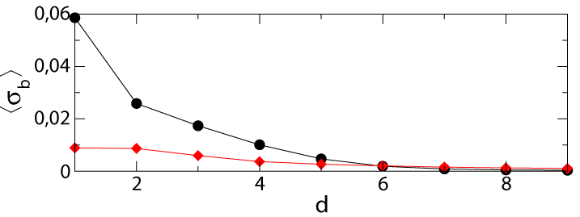

Profile similarity vs. social distance
Does similarity between user profiles depend on the social distance?
Topical overlap
Statistical correlation because of assortative biases?
Null model to discern real overlap from purely statistical effects
  No topical overlap other than that caused by statistical mixing patters
Notes:
Ok, so this preliminary study on assortativity and correlation led us to explore the correlation between the profile similarity of a pair of users and their distance on the social graph. So the crucial question is: “Does similarity between user profiles depend on social distance?”
To answer this question we first need a notion of similarity: for each user feature (books or groups or other) we compute the similarity between feature vectors using the cosine similarity, which formal specification is reported here, or the matching similarity, which is simply the number of items that the two users have in common. Using this two similarity metrics we computed the average similarity for people residing at distance 1, 2, 3 and so on (please look at the black curves). We observe a decay of the similarity with the distance.
However, this study is not enough to answer yes to our question, because this decay could be due to assortativity. Since very active users are usually connected with other very active users, it is very likely that they have a non-negligible number of items in common, just because their item sets are huge. So, the high similarity for users at distance 1 may be due to this purely statistical effect.
So, to discern statistical effects from real topical overlap we used a null model.
In the null model we simply assign random items to the feature vectors, preserving all the statistical properties of the real data like the number of items for each user vector. The result is represented by the red curves. We see that curves in the null model are considerably flatter, so we can conclude that correlation is not due to statistical effects. In the dynamical analysis we will inspect the reasons for such overlap pheomenon

Slide 10
Outline
Dataset
Static analysis
Geographic analysis
Dynamical analysis
Conclusions

Slide 11
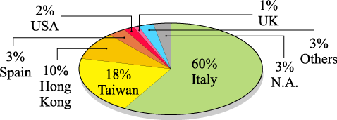
Motivations
…does geographical overlap hold in the network as well?
Dataset peculiarities
  Many users specify their home country (97%) or town (38%)
  Particular community distribution
Notes:
The study on the topical overlap led us to extend the previous question also for geographical features. In particular, “To what extent local topical overlap hold also for language and geographical features?”. The aNobii dataset allow to make this kind of analysis because many users specify their home country or town. Furthermore, aNobii exhibits a peculiar community distribution, whose implications on network topology are very interesting.

Slide 12
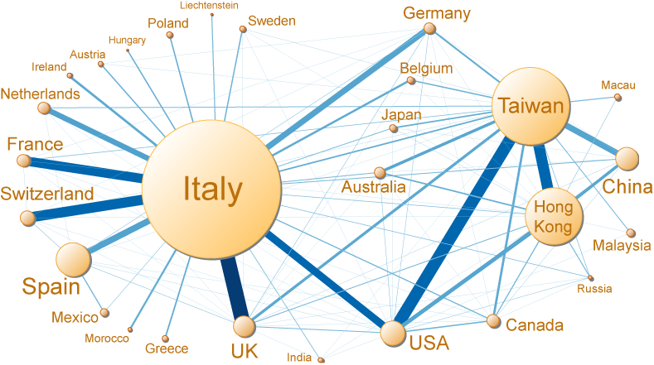
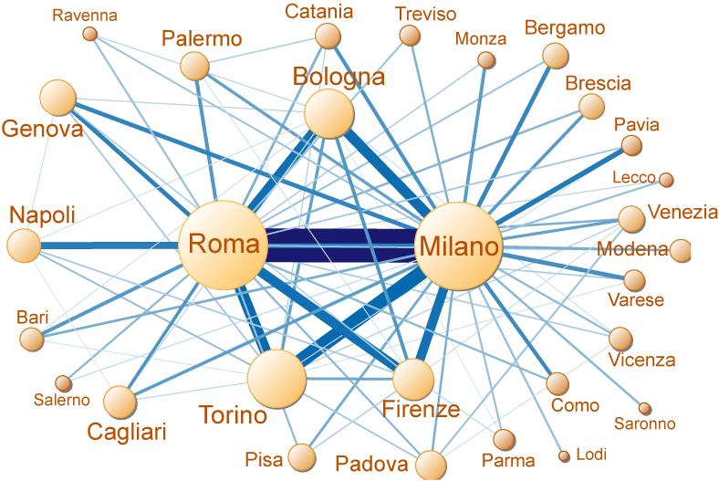
Geographical clustering
Country-level social network
Zoom on Italy
Notes:
The aNobii social network is in fact strongly clustered on a country basis. Here we see the country level sociogram. It clearly show that the network is partitioned into two main communities, almost disconnected between each other: the italian community and the Far East community. On the contrary, the town sociogram inside the countries is much more cohesive, like the italian cluster in this example.
This represent the first intuition to show a strong geographical overlap between people residing close in the social network.

Slide 13
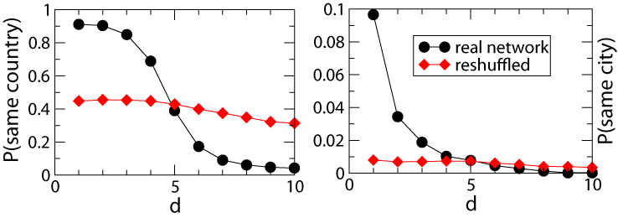
Geographic and language overlap
Null model test with random link rewire
Country-level overlap due to language barriers
City-level overlap for friendship (trivial…)
City-level overlap for neighborhood
  Bidirectional causality connection between acquaintance in real life and connectivity in the online social network
Notes:
We evaluate this intuition quantitatively using the same plot that we used for other features and recurring to a null model based on link rewiring, where people are connected at random but preserving their degree.
The interesting thing we notice is that the alignment is not only present for countries (which is expected given the deep language difference between the two main geographical clusters) but also for towns. Furthermore, this result holds for both friendship and neighborhood networks. Overlap for friendship tells us that people aquaitances in real life reside geographically close on average (which is a quite trivial observation), while overlap for neighborhood network tells us that user seek people who reside geographically close.

Slide 14
Outline
Dataset
Static analysis
Geographic analysis
Dynamical analysis
Conclusions
Notes:
The last topic is dynamical analysis

Slide 15
Triadic closure
Classification of new links at time t+1 between nodes already present at time t (t ∈ {1,…,5})
Double
closure
Closure
Direct
Reciprocated
Bidirectional
75%
20%
30%
25%
10%
Reciprocation is strong
Users tend to choose “friends of their friends” as new friends
Notes:
The first dynamical aspect we examined is triangle closure: we classified the new created links between snapshots t and t+1 in terms of triangle formation. In red we depict the new link, in blue the existing links.
First we confirm here a trend we outlined before: reciprocation.
Then we notice that users tend to select friends of theirs friends as new social contacts.

Slide 16
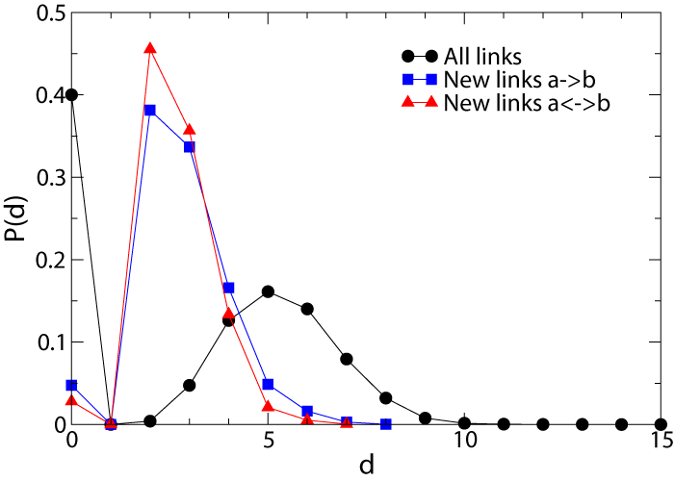
Proximity-driven attachment
Users tend to choose “friends of their friends” or people close in the social network as new friends
This process results in preferential attachment
Notes:
This results of course in a proximity-driven attachment that can be measured quantitatively by comparing the distribution of the distances between people who will be connected in the next temporal snapshot with the probability of being at distance d in the social network. Here we see that new links are formed between already close users. It has been shown in the literature that this proximity driven attachment process results, from a statistical point of view, in a preferential attachment phenomenon.

Slide 17
Causality between similarity and link creation
Topical overlap is observed for all profile features
Three possible explanations:
  Homophily (people connect with similar people)
  Social influence (social connection conveys similarity)
  Mixture of the two
Explore the causality relationship between profile similarity and social linking
  What is the cause of topical overlap?
Notes:
The second part of the dynamical analysis is about causality between similarity and link creation.
Statically, we observed that users are connected with similar people. However there could be three possible explanations for this observations.
First is homophily
Second is social influence
Or, alternatively, a mixture of the two.
We performed two experiments to show a two-way implication.

Slide 18
Similarity → link creation
 | 〈n_{cb}〉 | σ_{b} | 〈n_{cg}〉 | σ_{g}
d_{uv} = 2 | 9.5 | 0.02 | 1.12 | 0.05
u → v | 12.9 | 0.04 | 1.10 | 0.08
u ↔ v | 18.5 | 0.04 | 1.67 | 0.11
Closure | 18.2 | 0.04 | 1.81 | 0.10
Dbl closure | 23.4 | 0.05 | 1.20 | 0.12
Average similarity of pairs forming new links between t₀ and t₀+1 (t₀=4), compared with average similarity of all the pairs at distance 2 at time t₀
Pairs that are going to get connected show a substantially higher similarity
Notes:
To show that similarity leads to link creation (homophily) we measured the average similarity between pairs of users residing at distance 2 in the network and between pairs of users who will get connected in the next temporal snapshot. We see that, on average, the similarity calculated using books and groups vectors is about double for people that are becoming neoghbors if compared to the average computed for people at distance 2. This effect is stronger if the people that will be connected will establish a stronger tie (for example a double tie or a triangle closure). This experiment shows that homophily has a role in the link creation process

Slide 19
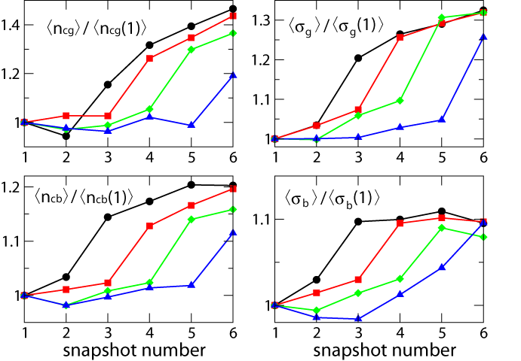
Link creation → similarity
Groups
Books
Evolution of the similarity between pairs linking together at different times
Notes:
The inverse implication is social influence: first, a link is established, then the newly connected users get influenced by each other and their similarity grows consequently. To show this, we measured the evolution of the similarity (in terms of books and groups) between pairs linking together at different times. For example, here the black line represent the average similarity, normalized on the initial similarity, of pairs that will be connected between time 2 and 3. The red line show the similarity between pairs that will get connected between time 3 and 4, and so on.
We notice that the similarity has a large jump when the link is created, thus revealing a profile alignment phenomenon determined by influence.

Slide 20
Outline
Dataset
Static analysis
Geographic analysis
Dynamical analysis
Conclusions

Slide 21
Summary
What are the dynamics that rule link creation?
  Reciprocation (in direct networks)
  Triadic closure
  Proximity-driven (preferential) attachment
    On geographical space
    On the social network
  Language-driven attachment
  Homophily
What is the interplay between user similarity and link creation?
  Tight coupling (topical overlap)
  Topical overlap is caused by homophily and social influence both

Slide 22
Future work
Link prediction
Information spreading
Extend analysis to other social systems

Slide 23
2nd IEEE International Conference on Social Computing
Thank you for your attention!
Speaker: Luca Maria Aiello
aiello@di.unito.it
www.di.unito.it/~aiello

