Slide 1
Secure and Flexible Framework for Decentralized Social Network Services
SESOC 2010: IEEE International Workshop on SECurity and SOCial Networking
Luca Maria Aiello, Giancarlo Ruffo
Università degli Studi di Torino
Computer Science Department
Speaker: Luca Maria Aiello, PhD student
aiello@di.unito.it
Keywords : social networks, privacy, access control, peer-to-peer

Slide 2
Privacy in OSNs
Online Social Networks are brimful of precious user information
Sensitive user data
User-generated content (photos, posts, feedbacks, activity…)
Social Network Service providers can arrange customizable privacy policies, but…
Not every provider adequately meets users’ privacy needs
Some users do not even accept to make their data available to the SNS providers

Slide 3
The p2p solution
When centralized data management is the problem, decentralization is the way
Replace the SNS centralized architecture with a peer-to-peer layer
PeerSon [1], Safebook [2], …
The new paradigm brings new challenges
Reliability: structured p2p systems are very vulnerable to attacks
Poisoning, Pollution, Sybil, Eclipse, MITM…
QoS and security : availability, updates, access control
[1] Buchegger, Schöiberg, Vu, Datta – 2009 [2] Cutillo, Molva, Strufe – 2009

Slide 4
Reconciliation
User demand for privacy and application reliability/security should be assured both
Our solution
A DHT-based framework
Strong identity is embedded at overlay level
Features (contributions)
Security to common attacks
Integration on an identity basis
Reputation management
Discretionary Access Control
(+ P2P tag-based search engine)

Slide 5
Likir[3] : a quick overview
An OpenId is coupled with ordinary DHT Id in a single identifier, signed by a Certification Service
Customized node interaction protocol
Two-way authentication
Verifiable content ownership (data are signed)
Effective protection against attacks
Widely shown by p2p community
This solves our first problem: reliability
[3] Aiello, Milanesio, Ruffo, Schifanella – 2008

Slide 6
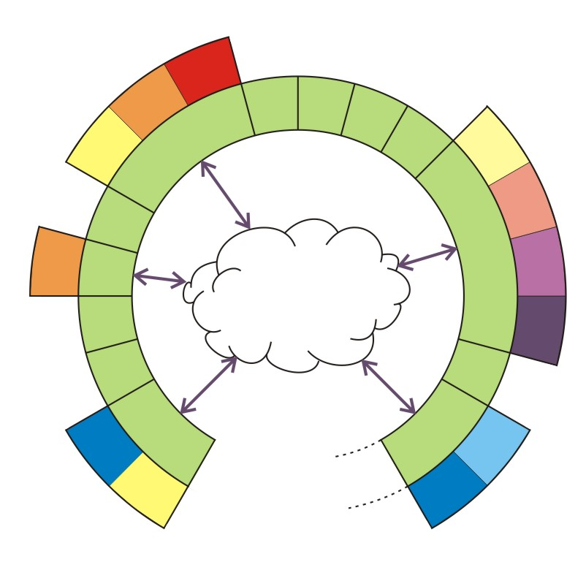
The idea: “SNS can be seen as a customizable suite of interoperable, identity-based applications”
Widget
Overlay node
How do we build a OSN on Likir?
Put-get
DHT
2 tasks:
Share data
Gather contents
User Identity
Application logic
Social Networking Service built on a identity-aware DHT

Slide 7
Identity-based services
The Likir layer offers identity-aware services to the widgets
Improved set of APIs
put(key, obj, ttl, type, public)
get(key, type, userId, recent, grant)
blacklist(userId)
Such simple primitives allow to reach important goals

Slide 8
Goals
Easy integration between widgets
Privacy
Cross-application reputation management
Efficient resource indexing

Slide 9
Goals
Easy integration between widgets
Privacy
Cross-application reputation management
Efficient resource indexing

Slide 10
Integration
Data exchange between different widgets
get(key, type, userId, recent, grant)
Allows identity based-filtering
UserId-driven search is
Safe (certificates)
Sharp (only one content is retrieved)
Mash-up on an identity basis
Likir applications provide public APIs for key/type production rules
Example
Wall posts can be fetched and displayed by other applications (e.g. instant messengers)

Slide 11
Tear down the wall!
OSNs are often “walled gardens”
Information flow between different OSNs is difficult
In a open and decentralized environment, this is no more a problem!
A single social graph emerges through widgets integration

Slide 12
Goals
Easy integration between widgets
Privacy
Cross-application reputation management
Efficient resource indexing

Slide 13
Privacy
There is no privacy in a open environment!
Simple data encryption is too little flexible
We need a system granting highly dynamic group membership

Slide 14
Discretionary Access Control (DAC)
Index nodes are the gatekeepers
They can perform identity-based access control because overlay interaction is authenticated
put(key, obj, ttl, type, public)
Private resources are returned only if a proper grant certificate is shown
get(key, type, userId, recent, grant)
Grants are distributed by an applicative DAC module

Slide 15
DACM: how does it work? (1)
The DAC module listens for incoming friendship requests
Accepted requests receive a signed grant certificate in response, which contains
The granted userId
A regular expression which determines allowed types
An additional encryption key is exchanged
Grants have an expiration time

Slide 16
DACM: how does it work? (2)
When a index node receive a request for a private resource, it verifies
Grant signature
Querier’s userId = grant userId
Requested content types matches the grant’s regular expression
If control fail a generic “content unavailable” message is returned

Slide 17
Privacy properties
Confidentiality
Contents saved in the DHT readable only to authorized users
Index nodes cannot read private data because of encryption
Anonymity
Participation to specific SNSs is private
Authorized disclosure
If the grant mechanism is extended also to local widgets, only authorized widgets can access to other widget’s data (no trojan horses)

Slide 18
Goals
Easy integration between widgets
Privacy
Cross-application reputation management
Efficient resource indexing

Slide 19
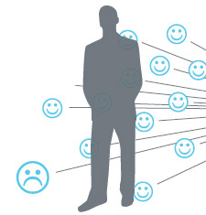
Reputation
Reliable partner selection through
reputation
Applicative Reputation System (RS)
Widgets give feedback to the RS on other users
When the reputation score of a user falls below a threshold, the RS calls:
blacklist(userId)
Subsequent interactions with “userId” are avoided at overlay level
Cross-application reputation → no whitewashing

Slide 20
Goals
Easy integration between widgets
Privacy
Cross-application reputation management
Efficient resource indexing

Slide 21
Resource search
OSNs use often folksonomies to
categorize items
In p2p OSNs, folksonomic search could fill another functional gap with corresponding, centralized web-services
Task
Mapping a bipartite <tag,resource> graph on a DHT
Mapping a tag-tag graph useful for navigation
Issue
Mapping of dense tag-tag graph is very inefficient

Slide 22
DHARMA
DHT-based Approach for Resource Mapping through Approximation
Idea: cutting off edges representing weak correlations between tags
Efficient tag insertion and navigation
The implementation details will be presented at HotP2P 2010

Slide 23
Social network client architecture
Unified GUI
Tag
Search
Reputation
System
Application
Suite
DAC
Module
Likir
UDP
TCP

Slide 24
Conclusions
Embedding strong identity at overlay level grants
Reliability
Flexible privacy services (Discretionary Access Control)
Reputation management
Proposal for implementing collaborative tagging system in p2p OSNs
Implementation
Likir, DHARMA and LiCha (simple IM application) are available
DACM is on the way

Slide 25
References
http://likir.di.unito.it
L. M. Aiello, M. Milanesio, G. Ruffo, R. Schifanella “Tempering Kademlia with a Robust Identity Based System”, P2P 2008
L. Maccari M. Rosi and R. Fantacci and L. Chisci and M. Milanesio and L. Aiello, “Avoiding Eclipse attacks on Kad/Kademlia an identity based approach”, ICC 2009
L. M. Aiello, M. Milanesio, G. Ruffo, R. Schifanella “Tagging with DHARMA, a DHT-based Approach for Resource Mapping through Approximation” HOTP2P 2010, to appear. April 23rd

Slide 26
SESOC 2010: IEEE International Workshop on SECurity and SOCial Networking
Thank you for your attention!
Speaker: Luca Maria Aiello, PhD student
aiello@di.unito.it

