Slide 1
Tempering Kademlia with a Robust Identity-based System
Luca Aiello, Marco Milanesio, Giancarlo Ruffo, and Rossano Schifanella
Giancarlo Ruffo
SecNet Group
Dipartimento di Informatica, Università degli Studi di Torino
Corso Svizzera, 185 – 10149, Torino, Italy
ruffo@di.unito.it - tel. (+39) 011 670 6771 fax. (+39) 011 751

Slide 2
Motivations
Can I trust this overlay? Are my items safe?
distributed system
12.5.7.31
berkeley.edu
planet
-
lab.org
peer
-
to
-
peer.info
89.11.20.15
95.7.6.10
86.8.10.18
7.31.10.25
Structured P2P systems are mature enough for applications
Scalable, resistant agaist random node failures
Still inadequate for dependable services
Too many known attacks
Node id and user id aren't coupled
When you are frauded, you have no one to blame!

Slide 3
Outline
Attacks on structured P2P systems
Attacks on identities
Attacks on routing
Attacks on storage
DDoS and MITM
Kademlia overview and vulnerabilities
Overview of Likir
Protocol
Security of Likir
Performance of Likir
Implementation of Likir
Layering applications and services on Likir
Conclusions and Future Work

Slide 4
Outline
Attacks on structured P2P systems
Attacks on identities
Attacks on routing
Attacks on storage
DDoS and MITM
Kademlia overview and vulnerabilities
Overview of Likir
Protocol
Security of Likir
Performance of Likir
Implementation of Likir
Layering applications and services on Likir
Conclusions and Future Work

Slide 5
Attacker model
A malicious node is a participant in the system that does not follow the protocol correctly
It can generate packets with arbitrary content
It can perform IP spoofing
It can intercept and modify communications between other nodes
It can collude with other attackers
It can run and control several nodes
[Sit, E., and Morris, R., 2002]; [Castro, M., 2002], …

Slide 6
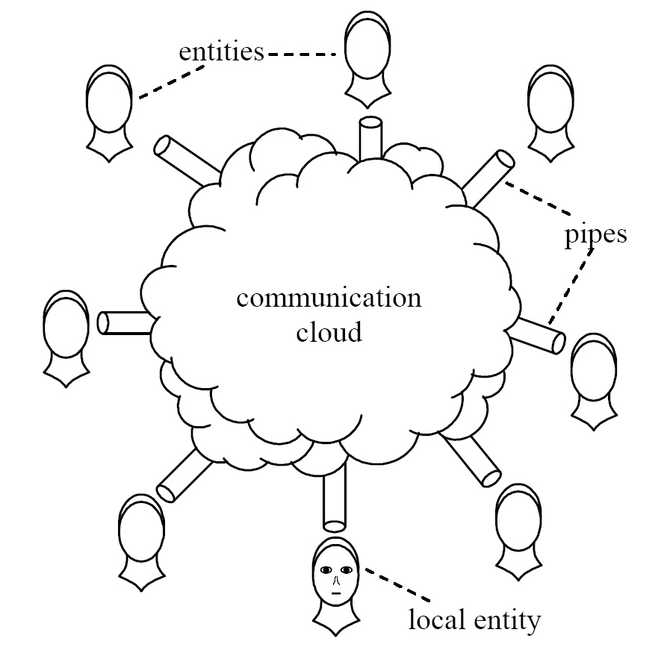
Sybil Attack
Entities E
Correct C ∪ Faulty F = E
Send messages
Each entity e attempts to present one legitimate identity
Each faulty entity f additionally attempts to present one or more counterfeit identities
Without centralized authority, Sybil attacks always possible except when:
All entities have nearly identical resources
All presented identities are validated simultaneously
When accepting identities not directly validated, required number of vouchers exceeds number of system-wide failures
Not justifiable as assumptions
Not practically realizable as requirements
[Doucer, J., 2002]

Slide 7
Routing Poisoning
A malicious node could corrupt the routing table with incorrect updates to neighbors
Systems that have the freedom to choose between multiple routes are especially vulnerable
Detection Mechanism: Verifiable routing updates

Slide 8
Eclipse Attacks
Separate a set of victims from the rest of the overlay network
Kind of routing poisoning, also known as partition attack
Node insertion attack: a vast number of nodes are initiated maliciously with ids close to a target key k: you can eclipse a stored content
Countermeasures:
Anonymous auding technique
Prevent node select their own id.
[Singh, A. et al, 2006 – Infocom 2006]

Slide 9
Other attacks on storage
Peers responsible for key k are asked to store all the pairs < k, v>, and return value v when requested. Value v can be a direct content or a reference (meta-data) to another source.
Index poisoning
v is a reference to a source, e.g., (IP addr, UDP port)
Insert many fake references < k , v₁>, < k, v₂>, …, < k, v_{n}>
Content pollution
v is a reference to a source of a file, e.g., (IP addr, UDP port, file metadata)
Insert many references to fake files
Used for censorships and for copyright protection (by Recording Association Industries)
Countermeasures: Credentials verification and Reputation management

Slide 10
Other well-known attacks
DDoS attack
Man in the Middle attack
Inducing a large number of nodes to overload a target node, both internal or external to the P2P system
It can be performed by way of index poisoning or content pollution
It is a very difficult to prevent all the kind of DDoS attacks
A node may intercept and modify forwarded messages
Very straightforward during recursive routing
Many nodes can be proxies for other peers behind NAT
Countermeasures:
Verification of integrity of messages and of the identity of the sender
Authenticated channels
Nonces against replay attacks

Slide 11
Kademlia: overview and vulnerabilities
Keyspace: 2¹⁶⁰
Distance metric: XOR
Route table: up to 160 k-buckets
At most k entries for each k-bucket
An entry is a reference: <IP addr, UDP port, NodeId>
For each i-th bucket, ids of nodes have distance between 2^{i} and 2^{i+1} from local id
Buckets arranged as a binary tree
Preferred for: Simplicity , performance, symmetrical buckets.

Slide 12
Kademlia: overview and vulnerabilities (cont'd)
Route table building strategy: splitting
Step 0: one void k-bucket
Step i: a new node is assigned to a k-bucket according the shortest unique prefix of its node Id
If the given bucket has less than k entries, the new node is inserted
If the bucket is full, and it contains the local node's id, than the bucket is split
Stop: when the bucket referring to the id of local node reaches depth 160.
Nodes in a k-bucket are ordered with a Least Recently Seen strategy
Four RPCs:
PING (id)
STORE (key, value)
FIND-NODE (key)
FIND-VALUE (key)

Slide 13
Kademlia: overview and vulnerabilities (cont'd)
Causes
Effects
Node Ids are not certified
No credentials and control during storage
No authentication
K-buckets' LRS strategy, and splitting procedure
No control on FIND-NODE results
Sybil and node insertion attacks
Index poisoning, content pollution and DDoS attacks
MITM + routing poisoning
Resist against index pollution, but not during splitting
If the receiver is malicious, it can return a set of references to non existing or colluding nodes

Slide 14
Kademlia's implementations
Kad
RevConnect
KadC
SharkPy
Khashmir
Plan-X
Azureus DHT
Mojito
Entangled
…
So many implementations prove that Kademlia has became very popular
But security has been understimated so far!
Moreover, all these API are hardly reusable for other applications than file-sharing

Slide 15
Outline
Attacks on structured P2P systems
Attacks on identities
Attacks on routing
Attacks on storage
DDoS and MITM
Kademlia overview and vulnerabilities
Overview of Likir
Protocol
Security of Likir
Performance of Likir
Implementation of Likir
Layering applications and services on Likir
Conclusions and Future Work

Slide 16
Likir overview
Layered Identity-based Kademlia-like Infrastructure
A Certification Service (CS) generates random nodeIds and bind them with their users' identities
User Ids can be his/her email address, as well as his/her OpenId URI
If OpenId is used, interoperability is simplified
The CS can (should) verify User Id credentials with SSO during registration

Slide 17
Notation

Slide 18
Initialization
When the node is executed for the first time, it needs an id
This is served by the CS, with a bootstrap nodes list
AuthId_{A} = Sign(NodeId_{A} || UserId_{A}||K⁺_{A}||exp_{A} , K⁻_{CS})
We assume that UserId is an existing identity that must be verifed by the given Id Provider
CS
Node A

Slide 19
Join and interactions with the CS
After initialization, join is executed as in ordinary Kademlia
The node execute FIND_NODE – using its own id – on bootstrap contacts
Bootstrap list is self managed from now on
CS is not contacted anymore, unless NodeId exprires
RPC are encapsulated in Likir authenticated messages

Slide 20
Nodes interaction
Nodes A and B initiates a four-way session when A wants B to execute a RPC
Auth_{AB} = Sign(NodeId_{B} || N₂ || H (RPC-REQ), K⁻_{A})
Auth_{BA} = Sign(NodeId_{A} || N₁ || H (RPC-RES), K⁻_{B})

Slide 21
Content Storage System
All the RPCs as in Kademlia, except for STORE
Storing is subject to credentials generation
Retrieval (FIND_VALUE) is subject to credentials verification.
If the owner wants to keep his content secret, he can encrypt it before storing

Slide 22
Identity Based Signature (IBS)
IBS is a cryptography technique that allows to compute a key pair whose public counterpart could be easily obtained from an ASCII string
We can rid of (RSA) public key in the protocol!
Does it worth the cost?
A four step process:
Setup: the Private Key Generator (PKG) creates a pair of master keys: MK⁺ and MK⁻.
Private Key extraction: PKG produces K⁻_{A} from Id_{A} and MK⁻.
Signature generation: A signs a message m with K⁻_{A}
Signature verification: B checks A's signature on m using Id_{A} and MK⁺.
[Shamir, A., 1985]; [Boneh, D., Franklin, M., 2003]

Slide 23
IBS consequences on Likir
The protocol is conceptually and structurally semplified
We do not need PKs
UserId is the main source for identification at both the application and the middleware levels
We need to bind only two identifiers (UserId and NodeId)
When you have an UserId, you can access related NodeId, and vice versa (and this information can be stored in the DHT)
PKG can be a part of the CS, or mounted on a different remote server
NodeIdReq = UserId_{A}
AuthId_{A} = Sign(NodeId_{A} || UserId_{A}|| exp_{A} , K⁻_{CS})

Slide 24
Security Discussion
Attacks on routing
Node ids cannot be generated ad hoc
Update communications are authenticated: an attacker can spread only its own id
Kademlia's LOOKUP vulnerability is ineffective
Attacks on storage
Usage of credentials with unforgeable signature, so you can trace back to the attacker identity
A reputation system can be used to punish/reward content owners
Sybil attack
Each node id corresponds to a different user account
Before a nodeId is released, the user must prove his/her identity
This mitigates, even if it does not solve the problem
Sybil attack is structural on Web 2.0!
MITM attacks
Messages in authenticated channels cannot be intercepted
Content replication is not altered by authentication

Slide 25
Drawbacks
Fake drawbacks, and…
Real ones!
CS is a single point of failure
Not always!
It is involved when an AuthId should be created or renewed
During off-times, the system can still work
PK management introduces overhead
True, but it is largely acceptable
IBS needs a PKG
This is a single point of failure, due to key escrow problem
IBS is efficient in theory, not in practice
We did not find an open and efficient implementation
IBS introduces extra overhead
Ok, this does not scale very well…

Slide 26
Overhead evaluation with cryptographic microbenchmarks
The protocol makes both sender and receiver to generate and to verify signatures
SHA-1 operations are not considered due to (relative) low cost
Each primitive is affected
FIND-VALUE should verify n signatures, for each retrieved content's Cred

Slide 27
Overhead evaluation with cryptographic microbenchmarks (cont'd)
We measured the execution of a C prototype
GNU OpenSSL library
1024 RSA for signing
SHA-1 for hashing
Pairing Based Cryptograhy (PBC)
Quad-Core Xeon 2.5 GHz with 4 GB RAM, running Linux Ubuntu 7.01
Each test performed 1000 times

Slide 28
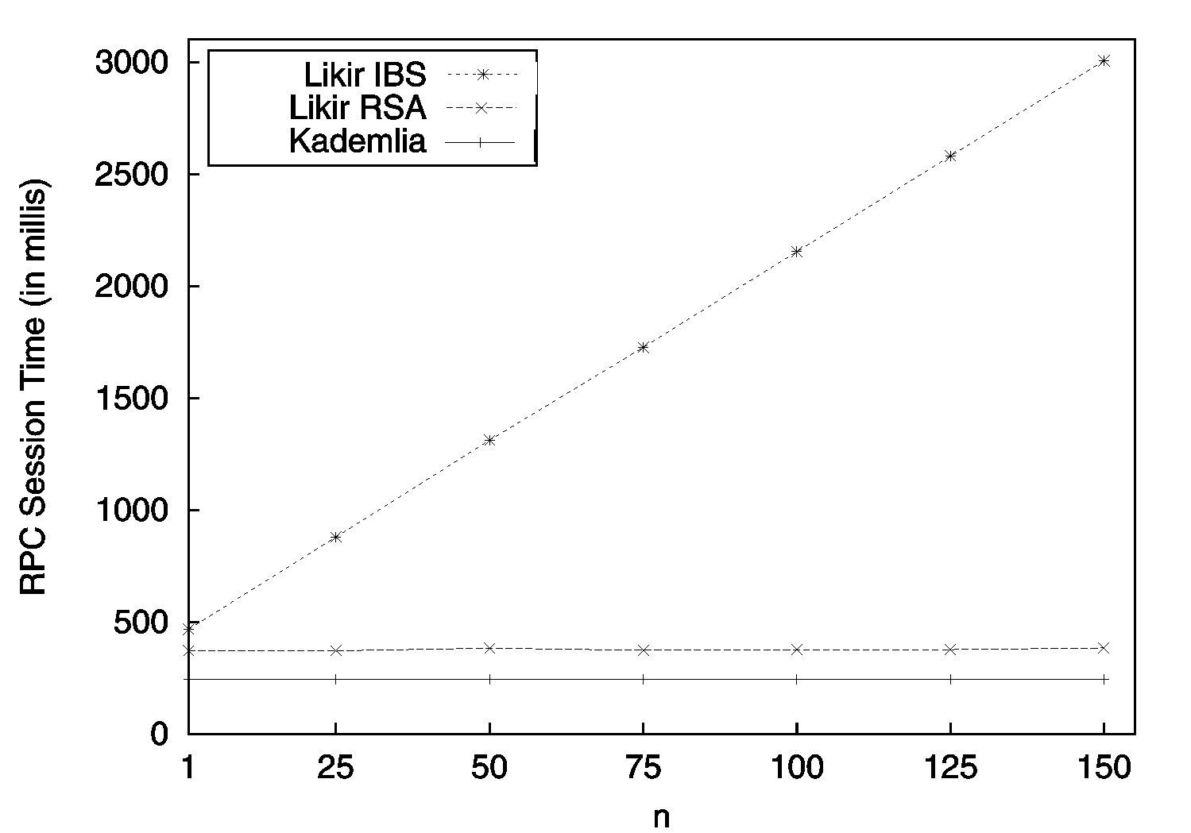
Single session's computational effort estimation
Likir introduces additional costs (e.g., nonce exchanges)
We wanted to estimate such a overhead at each session
We executed two instances of Likir in two (geographically distant) nodes running on PlanetLab
We perfomed a test for each primitive
Each test is made of 500 executions
FIND VALUE RPC Session

Slide 29
Discussion
RSA overhead at the node side is limited, and it does not compromise the system
IBS scheme introduces a linear degradation when the number of content stored at each node grows
There are schemes of aggregate signatures [Boneh, B., et al, 2003] that can be verifyed in batch. Is it enough? (on going work)
It is possible to check by sample, instead of checking all the messages? Which is the best trade off between security and performance? (planned work)
CS is a single point of failure during registration. Can we distribute the load of this service? (on going work)

Slide 30
Likir Implementation
JLikir: implemented with Java 1.6.0
The package includes a prototype CS
On going work: NAT traversal

Slide 31
Applications using Likir
Student Challenge: it will be launched (again) on 2009 at our university – but of course, it can be extended!
Award: of course, the Glory ☺ and a good exam's evaluation.
LiCha (Likir's Chat) has been completely built on top of Likir
Serverless chat
You can log in if you have an OpenId account
An user can access from any point in the network, (securily) retrieving his buddy list from the DHT
Node's state information are stored/retrieved to/from the DHT

Slide 32
Thank you for your attention
Questions?
Giancarlo Ruffo
SecNet Group
Dipartimento di Informatica, Università degli Studi di Torino
Corso Svizzera, 185 – 10149, Torino, Italy
ruffo@di.unito.it - tel. (+39) 011 670 6771 fax. (+39) 011 751

