Slide 1
Tagging with DHARMA A DHT-based Approach for Resource Mapping through Approximation
Seventh International Workshop on Hot Topics in Peer-to-Peer Systems
Luca Maria Aiello, Marco Milanesio
Giancarlo Ruffo, Rossano Schifanella
Università degli Studi di Torino
Computer Science Department
Speaker: Luca Maria Aiello, PhD student
aiello@di.unito.it
Keywords : navigational search, folksonomy, DHT,
approximated graph mapping, last.fm

Slide 2
Overview
Goal: enrich the p2p layer with a tag-based navigational search engine
Task: mapping a folksonomy on a DHT
Problem: mapping dense graphs on distributed layer is very inefficient
Solution: approximated mapping using a complexity-bounded algorithm
Evaluation: the approximated solution does not upset the structure/semantic of the folksonomy

Slide 3
Motivations
Direct search
Navigational search
Taxonomies (e.g. Yahoo! directory): not successful
Folksonomies: successfully emerging thanks to the social web
Tag-based search engine on DHTs is profitable
Applications layered on DHTs use exact match search (e.g. eMule) → folksonomic search adds flexibility
Recent research activity on P2P for privacy-aware online social networks
Folksonomic search engine is an important OSN feature
Notes:
We know that in web services as well as in distributed systems we can have two different research paradigms. The first is of course direct search: given a query or a keyword I get a set of resources back. The second paradigm is the navigational search, where there is a set of categories I can browse to reach a resource that somehow matches the whole set of keywords I browsed (for example yahoo directory).
Categories in the navigational search were traditionally organized in predefined taxonomies. This approach wasn’t really very successful, because often predefined classifications don’t really match the mental categories of the users. However, in last few years, thanks to the social web, a navigational paradigm based on folksonomies is becoming more and more popular. Here, the users build a object classification in a bottom-up fashion by assigning arbitrary tags to objects.
Given this setting, we think that building such folksonomy based search engine on a DHT can be a good opportunity for two reasons. First, this can be a successful way to limit the well known exact-match lookup problem which affects the DHTs, adding flexibility to the p2p layer. The second is that recent works are trying to implement online social network services on DHTs, in order to better preserve user information privacy. Since online social networks often use the folksonomic paradigm for object location, the present work well complement this new research trend.

Slide 4
Folksonomies structure
Represented as a tripartite hypergraph
metal
classic
John
Metallica
Iron Maiden

Slide 5
Tag-Resource Graph (TRG)
Projection on user dimension
metal
classic
Bipartite graph
Edges are weighted depending on number of tag assignments
John
3
5
1
Metallica
Iron Maiden

Slide 6
Folksonomy graph (FG)
Models tag-to-tag similarity with co-occurrence
8
5+3=8
metal
classic
1+2=3
3
5
1
Co-occurrence similarity is widely known and used
Local calculation
Directional
3
2
Metallica
Iron Maiden

Slide 7
Folksonomic search
classic
thrash
8
3
grind
1
metal
12
power
5
9
7
Iron Maiden
Metallica
Manowar
User selects a tag
Related resources and tags are displayed
Ranking based on arc weights
User can shift to another tag or select a resource

Slide 8
Folksonomy evolution
The folskonomy grows quickly due to massive user activity
Resource insertion
Tag insertion
Both FG and TRG should be updated properly!

Slide 9
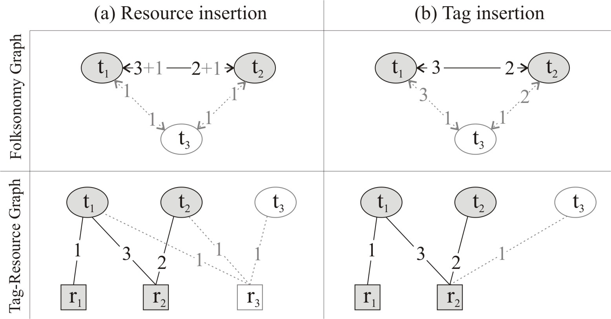
Folksonomy maintenance

Slide 10
Mapping on a DHT
Map FG and TRG on the DHT and implement the update operations on the distributed layer
Idea:
Splitting the FG and TRG into small structural parts or modules
Each module contains a node (tag or resource) and its outgoing edges/arcs
Each module is mapped on a different p2p index node

Slide 11
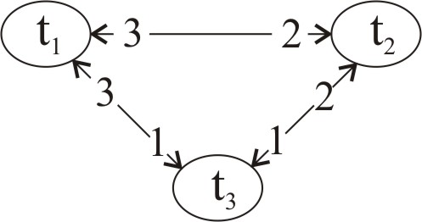
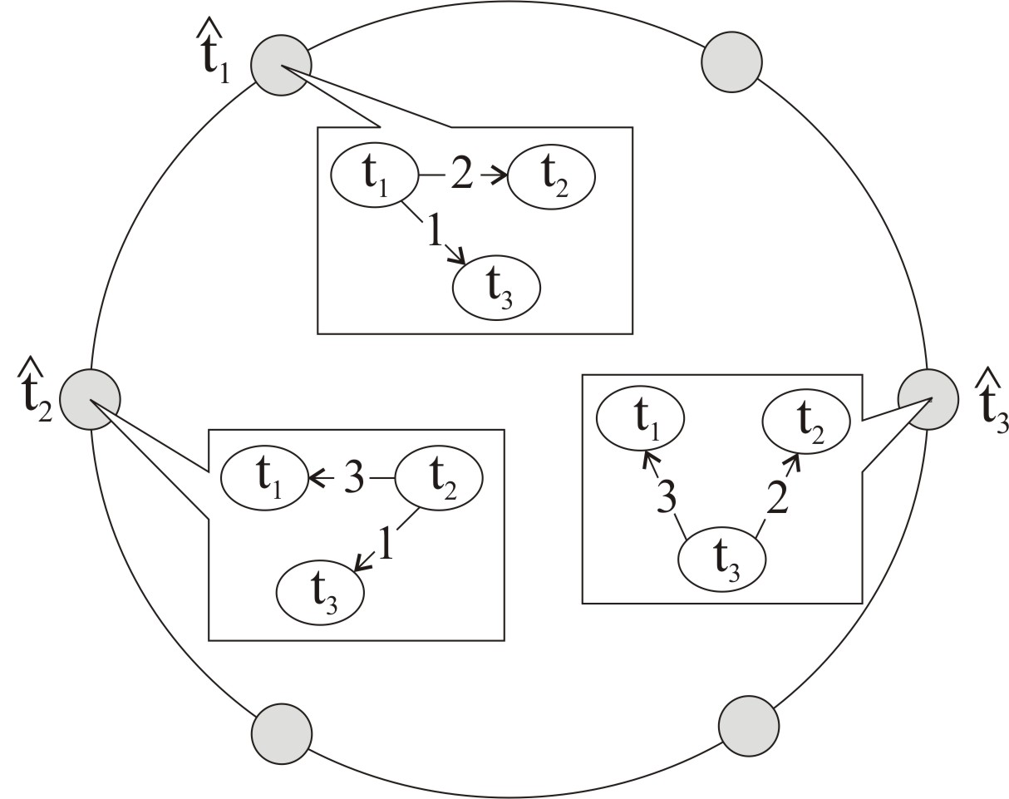
Mapping FG on a DHT

Slide 12
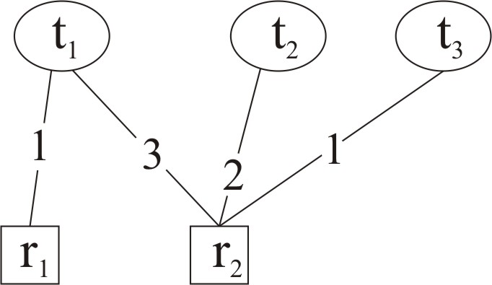
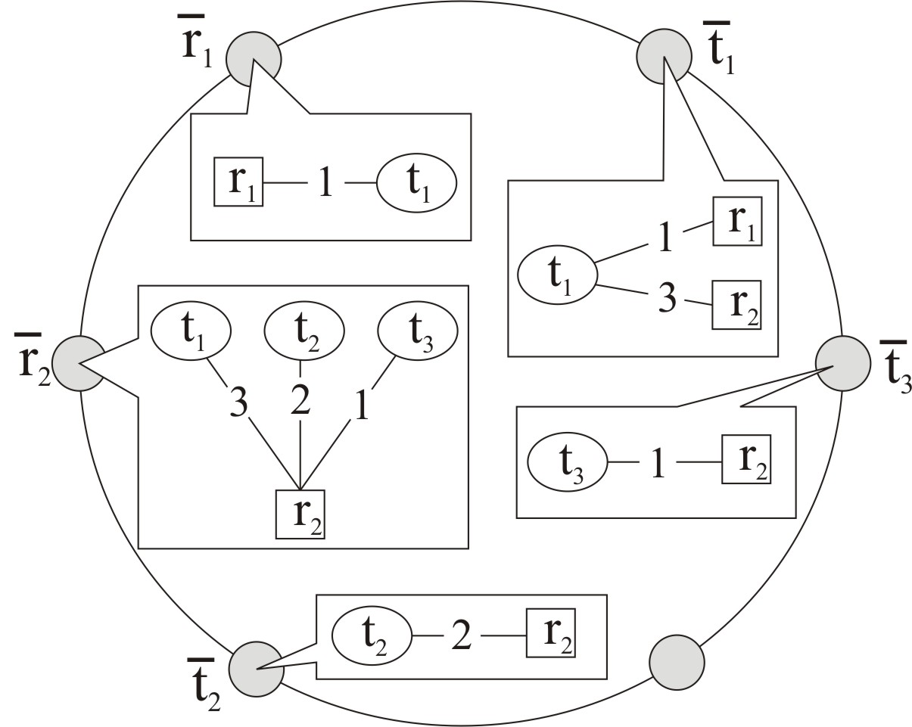
Mapping TRG on a DHT

Slide 13
Folksonomy maintenance on the DHT
When inserting a new tag or resource, proper modules have to be modified
Complexity of resource insertion and search are linear with the input size → OK!
Tagging operation is linear with |Tags(r)|
Tags(r) is the set of tags labeling the resource r
How many tags for a resource?
Let’s see a real-world example…
 | Insert(r, t₁,…, t_{m}) | Tag(t,r) | Search step
#lookups | 2 + 2m | 4 +|Tags(r)| | 2

Slide 14
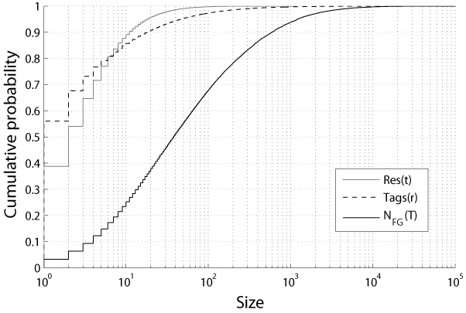
Last.fm folksonomy sample
|Tags(r)|
Can be huge!
99,405 users, 1,413,657 items and 285,182 different tags

Slide 15
An approximate solution
DHARMA
DHT-based Approach for Resource Mapping through Approximation
Idea:
Put a constant upper bound to the number of lookups for tagging operation
The resulting FG will be approximated…

Slide 16
Approximate tagging: k=1
classic
thrash
metal
cool
Now, select k tags at random in Tags(Metallica) and link them with the new tag
Metallica
Lookup count :
5
3
4
0
1

Slide 17
Approximate graph vs real graph
With DHARMA approximation, the complexity is affordable for very small k
The smaller k is, the more the structure of the Folksonomy Graph is upset!
We need to compare the approximate and the real Folksonomy Graph
 | Insert(r, t₁,…, t_{m}) | Tag(t,r) | Search step
#lookups | 2 + 2m | 4 + k | 2

Slide 18
Approximation in Last.fm
We simulate the evolution of FG with the approximated protocol
Simulated resource insertion and tagging activity
Goal: draw a comparison between the real Last.fm FG and the approximated FG, for different values of k
Nodal degree
Arcs weight

Slide 19
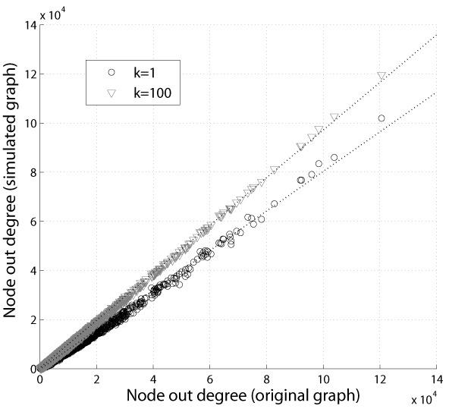
Nodal degree comparison

Slide 20
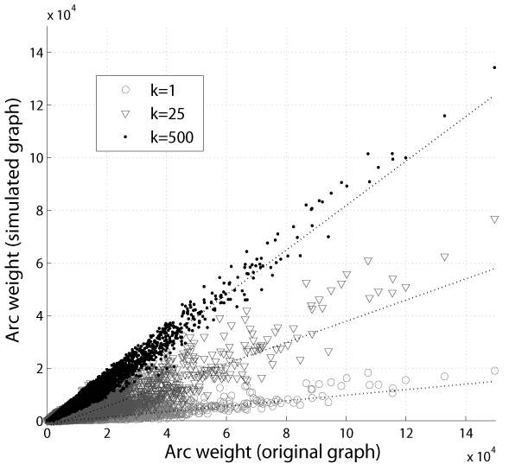
Arc weights comparison

Slide 21
Keeping proportions
Simulated and real graph are different but…
…they should not necessarily be equal
Only proportions must be kept
Arcs weight ordering must be kept
Proportion between weights is not lost (no flattening)
Only the “less informative” arcs should be deleted
Same proportions grant the preservation of the navigational semantic

Slide 22
Keeping proportions: k = 1
Arcs weight ordering is kept
Kendall’s tau measure between arcs weight rankings is very high (0.7) → OK!
Proportion between weights is not lost (no flattening)
Cosine similarity between arcs weight sets is very high (0.8) → OK!
Only “less informative” arcs are deleted
40% of arcs gets lost, but 99% of them has weight <= 3 → OK! (we wipe out only noisy links)

Slide 23
Query convergence rapidity: results
Steps |  | Last | Rand | First
Original graph | μ | 3.47 | 6.412 | 33.94
 | σ | 1.4175 | 4.4587 | 15.9942
 | μ_{1/2} | 3 | 5 | 33
Approximated graph | μ | 3.38 | 5.2140 | 19.17
 | σ | 1.2373 | 2.6994 | 10.3065
 | μ_{1/2} | 3 | 5 | 16
A query converges through subsequent filtering on the resource set
Estimation of convergence with simulation
Convergence is quick
Simulated search has no semantic notion
Approximation speeds up the search

Slide 26
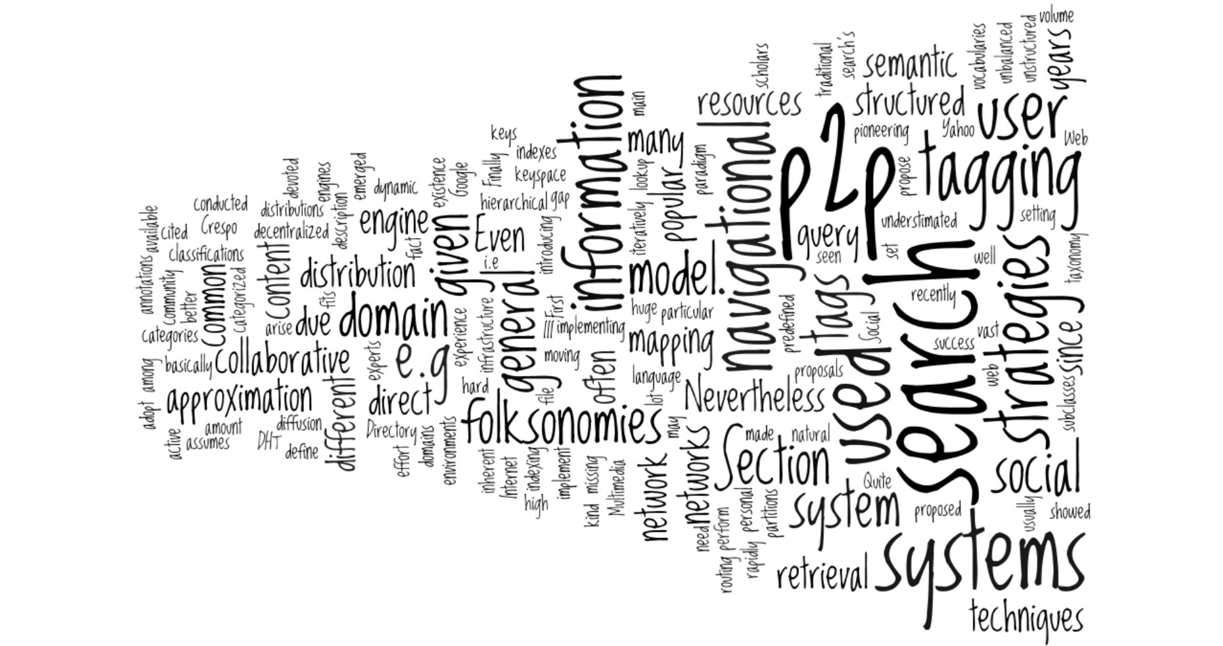

Slide 27
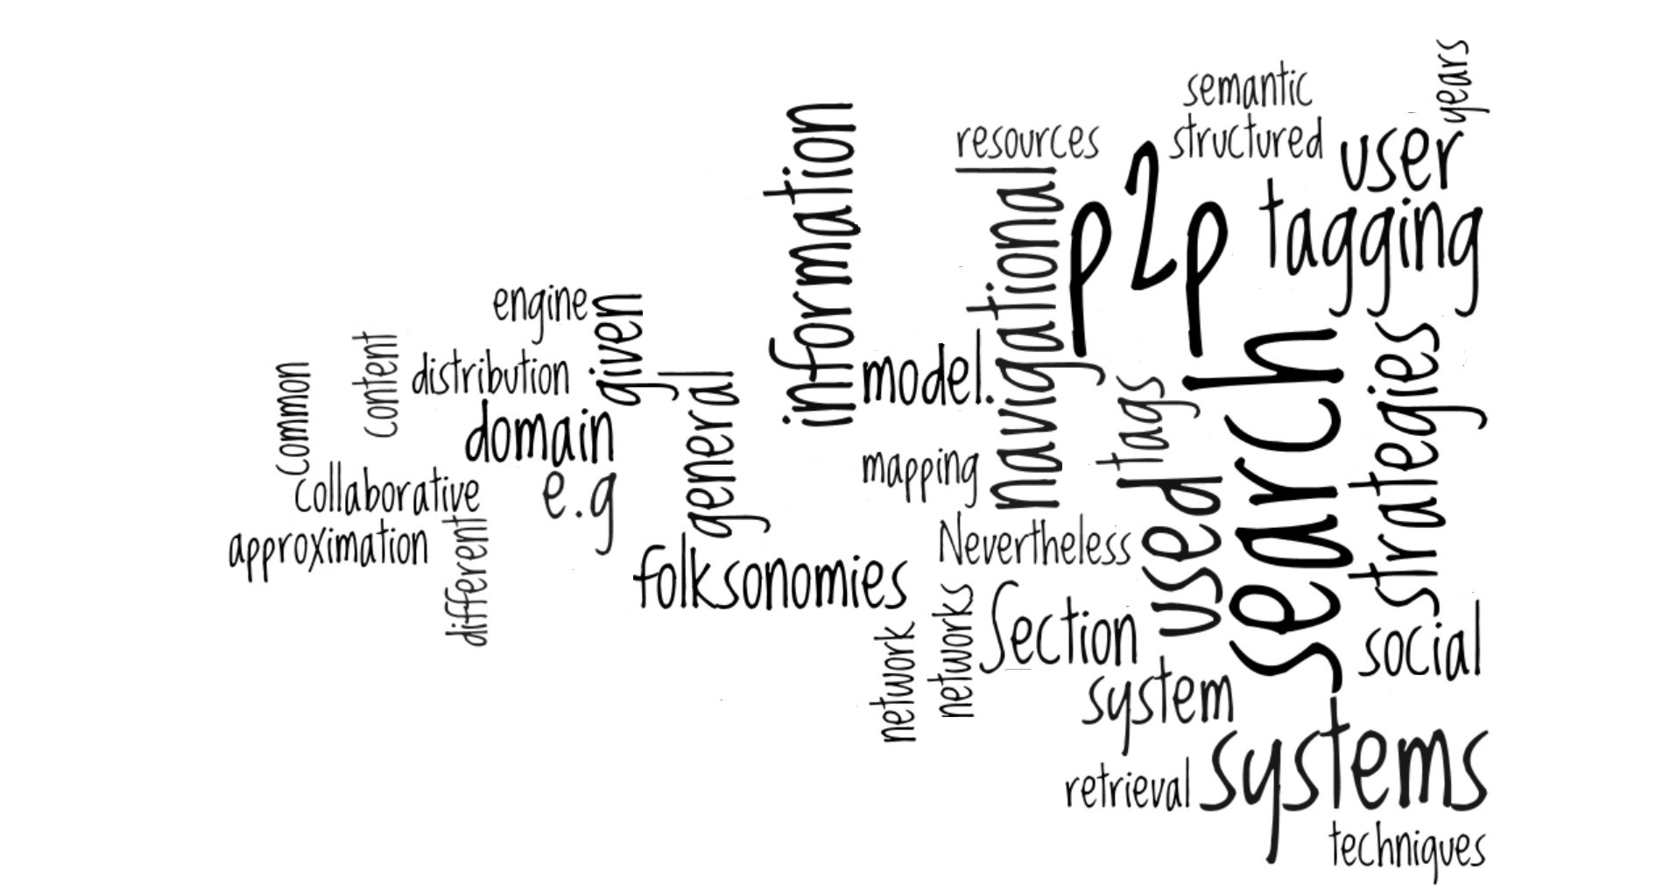

Slide 28
Conclusions
Approximated folksonomy mapping allows an efficient P2P implementation
The information lost in approximation is prevalently noise (automatic filtering)
Search navigation realizes vocabulary specialization, converging to narrow semantic categories
Convergence is quick (and even quicker with approximation)
DHARMA (Java implementation) is available at: http://likir.di.unito.it/applications

Slide 29
Related works
Other attempts in mapping folksonomies on p2p systems:
E.g. Tagster [1]
Privacy-aware P2P online social networks
Safebook [2], PeerSon[3], Likir[4,5]
[1] Görlitz, Sizov, Staab – ESWC 2008
[2] Cutillo, Molva, Strufe – WONS 2009
[3] Buchegger, Schöiberg, Vu, Datta – SocialNets 2009
[4] Aiello, Milanesio, Ruffo, Schifanella – P2P 2008
[5] Aiello, Ruffo – SESOC 2010

Slide 30
Seventh International Workshop on Hot Topics in Peer-to-Peer Systems
Thank you for your attention!
Speaker: Luca Maria Aiello, PhD student
aiello@di.unito.it

